Slide 1
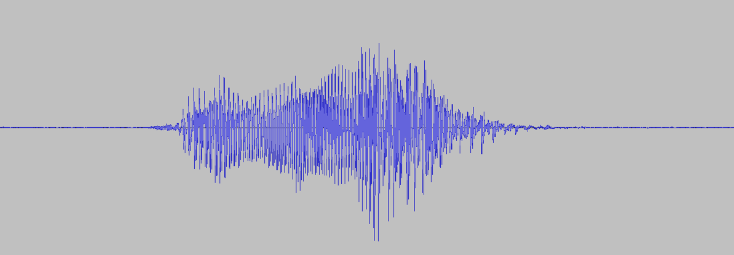
Dynamic Microphone
Condenser Microphone
Coil
Electrical signal
Electrical signal
Resistor
Magnet
Diaphragm and Capacitor
Diaphragm
Battery
“hello”
+
0 V
-

Slide 2

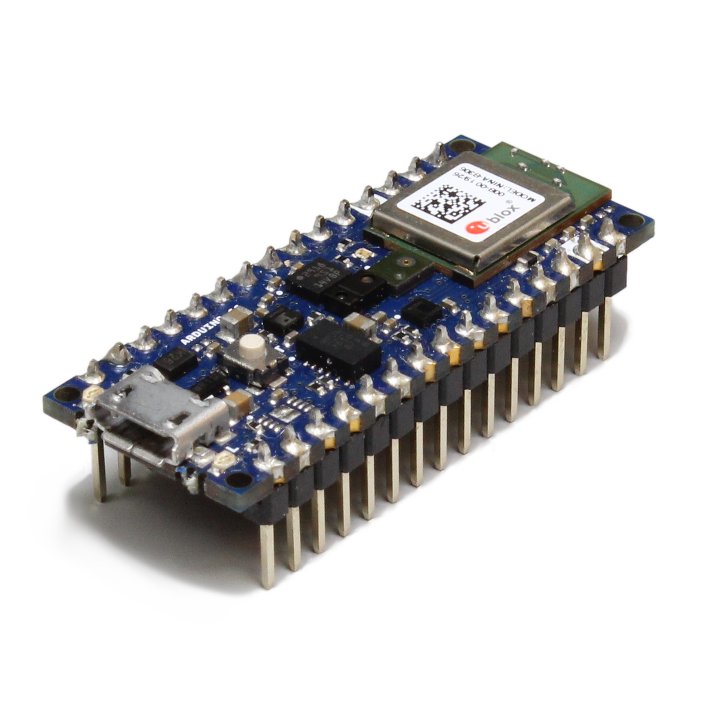
Sampling Rate
Data collection:
f_{s} = 44.1 kHz
voltage
time
To training
T
Sampling period (T): 62.5 μs
Sampling rate (f_{s}): 1/62.5 μs = 16 kHz
Inference:
f_{s} = 16 kHz
Model

Slide 3
Bit Depth
4-bit Quantization (16 levels)
voltage
voltage
time
time
T
16-bit Quantization (65,536 levels)
voltage
Sampling period (T): 62.5 μs
Sampling rate (f_{s}): 1/62.5 μs = 16 kHz
time

Slide 4
Collect data for training
Model
Deploy model

Slide 5
Collect data for training
Model
Deploy model

